Slide 1
Git & Git-Hub Spring Basic Spring JMS Hibernate Spring Hibernate Integration
Kunal Kishor

Slide 2
Agenda of this Training
Basic of Git & GitHub work flow
Spring Framework overview
Spring Architecture
Inversion of control (container)
Spring IOC
Spring Bean
Spring Bean Scope
Spring Bean life cycle
Dependency Injection
Constructor Injection
Setter Injection
Spring Module
Spring Core
Spring Context
Spring Beans
Spring SPEL
Spring Framework Data Access
JMS Module

Slide 3
Hibernate
Hibernate Overview
Hibernate Architecture
Hibernate and Java Persistence API (JPA)
Domain Model Classes
Hibernate Mapping XML Configuration
Hibernate Configuration Files
Hibernate Session Factory
Spring Hibernate Integration
Model classes & entity classes
DAO Classes
Spring Configuration file for hibernate

Slide 4
Git & GitHub
Introduction of Git & Git-Hub
Version Control System
Centralized version control system (CVCS).
Svn (subversion)
IBM Clear Case
Distributed/Decentralized version control system (DVCS).
Git
Advantage of Git
Free and open source
Fast and small
Implicit backup
Security
No need of powerful hardware
Easier branching

Slide 5
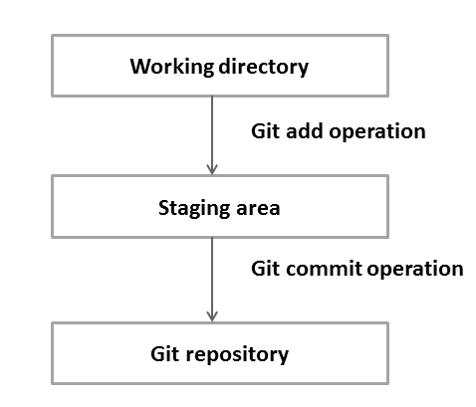
Git Work Flow git terminologies

Slide 6
Key Points
Local Repository & Remote Repositories
Working Directory and Staging Area or Index
Branches (trunk in sub version, every branch is referenced by head)
Clone
Commit (SHA1 secured Hash)
Tag (a meaning full name for every commit)
Pull
Push
Head (pointer refered to latest commit)
Log
URL
fetch

Slide 7
Git config-
git config --global user.name “kunal kishor“
git config --global user.email
Avoid merge commits for pulling-
git config --global branch.autosetuprebase always
Color highlighting
git config --global color.ui true
git config --global color.status auto
git config --global color.branch auto
Setting default editor

Slide 8
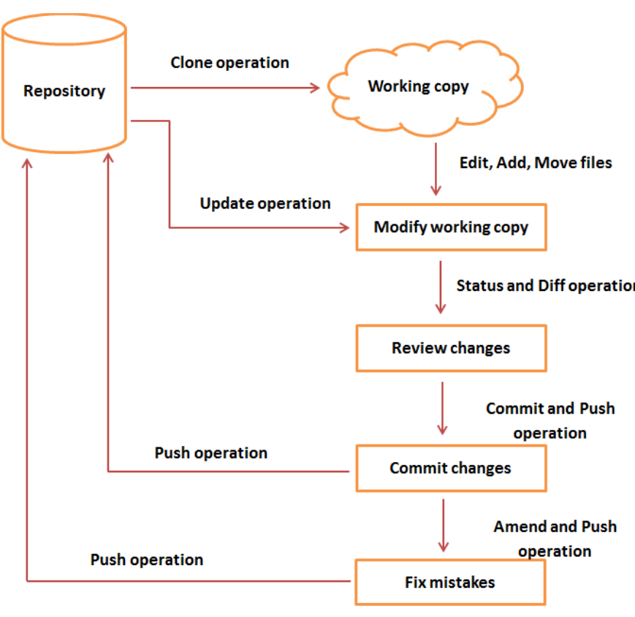
Git Life Cycle

Slide 9
Git Operation
Create a bare repository
Git –-bare init
Git init
Generate public private key
Ssh-keygen –t rsa -b 4096 –c “email id”
Log
Git log
Git show sha1
Git diff
Git status –s
Git commit --amand -m “msg” to view commit log
Git push origin master
Git stash ( to keep your change in stash but not commit and moved to other branch)
Git stash list
Git stash pop
Git mv file ./area (to move file)
Git mc old new
Git rm (delete)
Revert your changes
Git checkout
Git reset –-SOFT HEAD
Git reset HEAD

Slide 10
Git tag –a “tag name” –m “msg” ‘HEAD’
Git push origin tag “tag name”
Git show tagname
Delete tag – git tag –d “tag name”
Patch file
Git amand (git am )(both)
Git apply (modify local copy without commit)
Create branch
Git branch “branch name”
Git checkout branchname (to switch between branch)
Git checkout –b “branch name)
Git branch –d “name” (delete branch)
Git branch –m “new” old ( rename branch)
Git merge branch name
Resolve conflict
Git diff
Git commit

